Slide 1
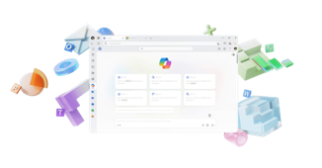

















Insert Partner
Logo Here
AI Productivity + Advanced Security.
One smart bundle.
      The most secure AI solution for your business.
      Take the guesswork out with built in security you can trust. Advanced protection included to keep your business data and devices safe. Extend with optional security add-ons for even more peace of mind.
Best-in-class productivity
AI built for work
Enterprise-grade security
+ more
Microsoft 365
Business Premium
Microsoft 365
Copilot Business
Microsoft Purview Suite for Business Premium
Limited time offers!
The most secure AI solution for only $15 more per user/month
M365 Business Premium + Copilot Business + Microsoft Purview
Secure AI productivity for only $10 more per user/month
M365 Business Premium +
Copilot Business
Advanced security add on for
only $5 more per user/month
Microsoft Purview Suite
Purchase requirements: Qualified purchase of 10 to 300 licenses required during the promotion period of December 1, 2025 – March 31, 2026.
Ready to get started?
Contact the <Partner Name> team.
user.name@company.com
company.com
linkedin.com/username
© Microsoft 2025. All rights reserved.
MICROSOFT MAKES NO WARRANTIES, EXPRESS OR IMPLIED, IN THIS SUMMARY

